Slide 1
Requirements Gathering and Analysis
Some content adapted from Rajib Mall’s book and Craig Larman’s book.

Slide 2
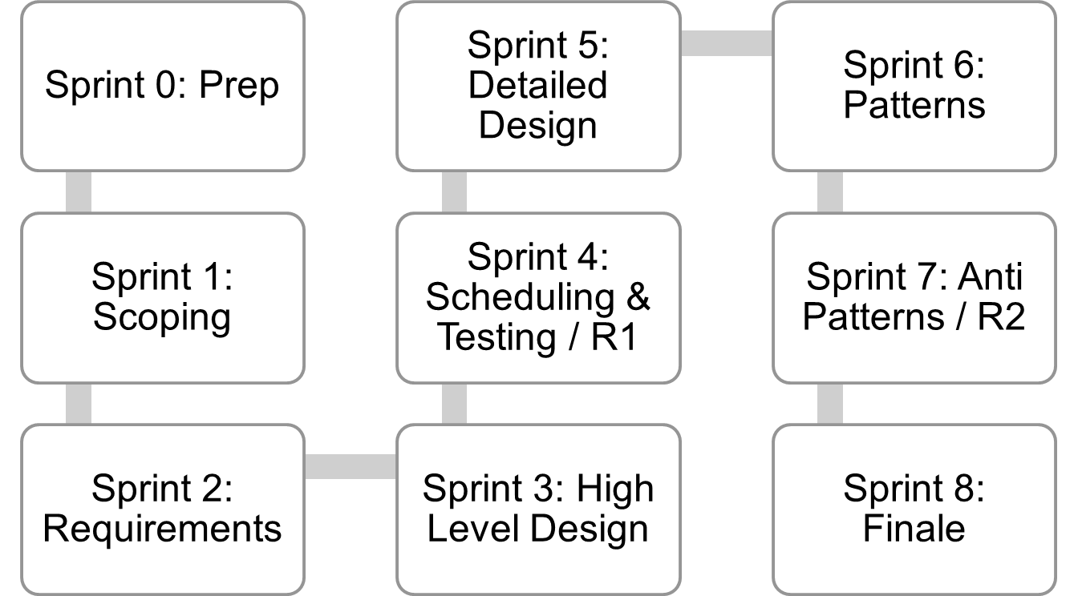
Where are we..
Jan 4
Mar 12
Mar 26
Lecture topics will follow this flow
As the projects tracks these sprints
Submissions due along the way
Guest lectures from startups and Industry leaders
EACH SPRINT IS 2 WEEKS, Friday start.
Jan 15
Feb 26
Apr 9
Jan 29
Feb 12
April 23
April 23+ EVALUATIONS

Slide 3
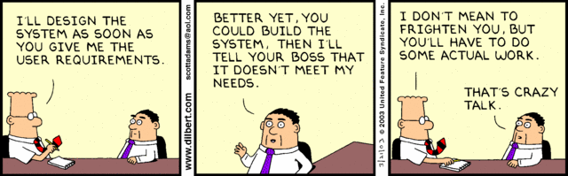
Why requirements gathering?

Slide 4
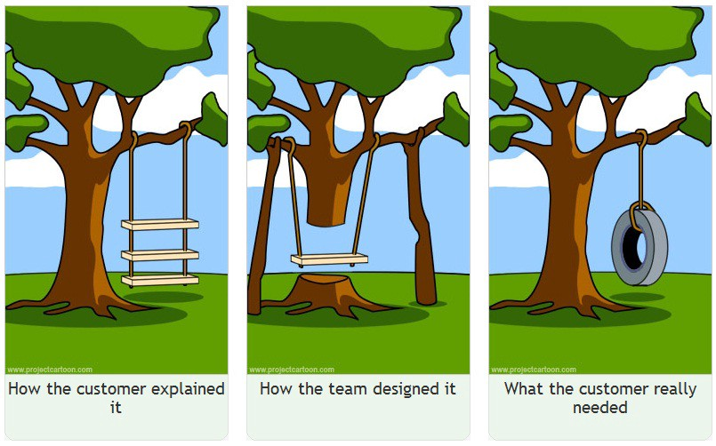
Need to “know” what to build

Slide 5
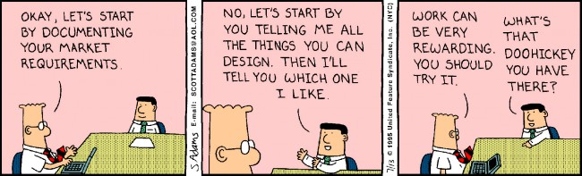
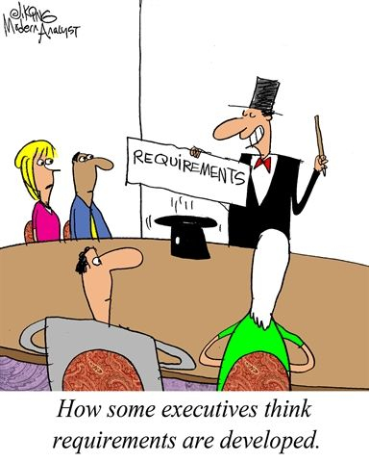
This way?

Slide 6
Consider this..
“Build an app for Felicity” . OK go build now!
Can you?

Slide 7
Requirements

Slide 8
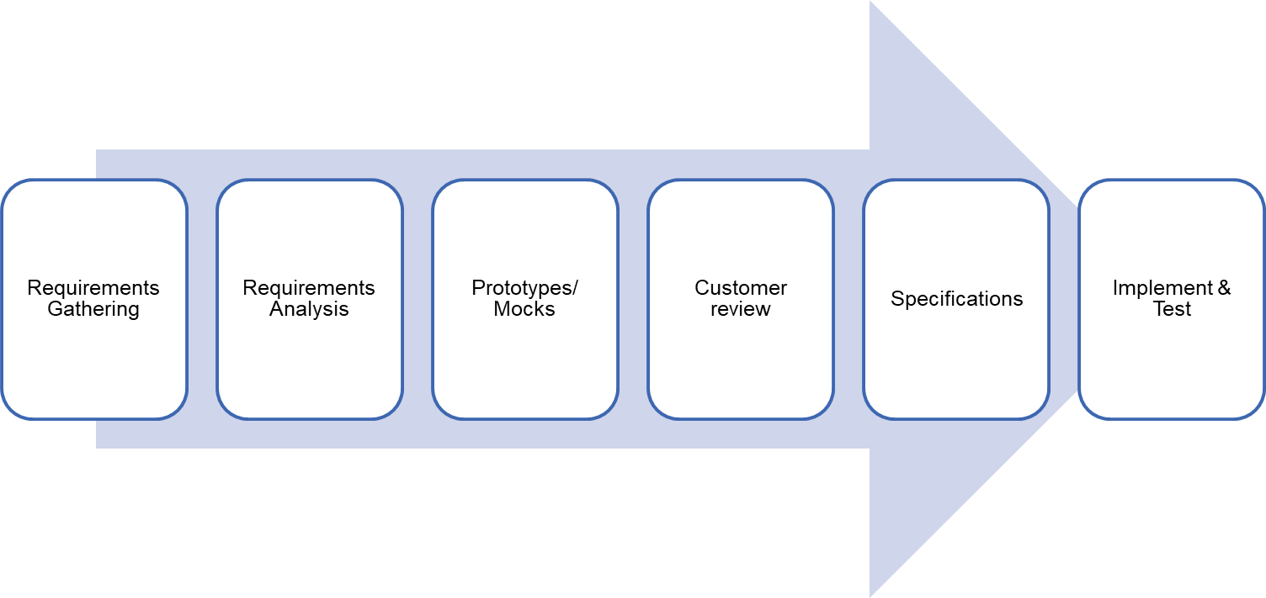
Requirements process

Slide 9
Types of Requirements
Business requirements
  High-level objectives of the organization or customer who requests the system.
Functional requirements
  Describe what the system should do
  For example, features (use cases)
Non-functional requirements
  Constraints that must be adhered to during development
  For example, quality constraints, technology constraints, process constraints, etc.

Slide 10
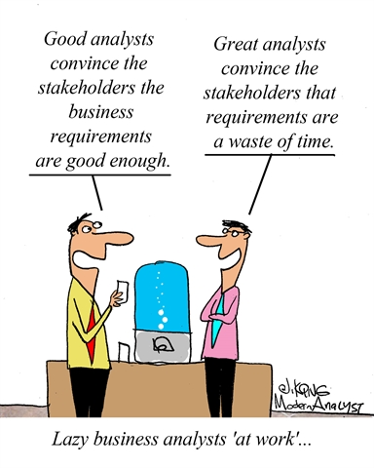
Analysis

Slide 11
Quality Requirements
Correct – only user representative can determine
Feasible – get reality check on what can or cannot be done
  technically or within given cost constraints.
Necessary – trace each requirement back to its origin
Unambiguous – one interpretation
Verifiable – is it complete
  how to you know if the requirement was implemented properly?
Prioritized – function of value provided to the customer

Slide 12
Requirements Gathering and Analysis
Some content adapted from Rajib Mall’s book and Craig Larman’s book.

Slide 13
Requirements Phase
Many projects fail:
  Because they start implementing the system.. Without determining whether they are building what the customer really wants.

Slide 14
Why Requirements analysis/specification?
Factors that cause projects to fail:
Lack of User Input 12.8%
Incomplete Requirements & Specifications 12.3%
Changing Requirements & Specifications 11.8%
Lack of Executive Support 7.5%
Technology Incompetence 7.0%
Lack of Resources 6.4%
Unrealistic Expectations 5.9%
Unclear Objectives 5.3%
Unrealistic Time Frames 4.3%
New Technology 3.7%
Other 23.0%
Standish Group, The Standish Group Report: Chaos, 1995, http://www.scs.carleton.ca/~beau/PM/Standish-Report.html

Slide 15
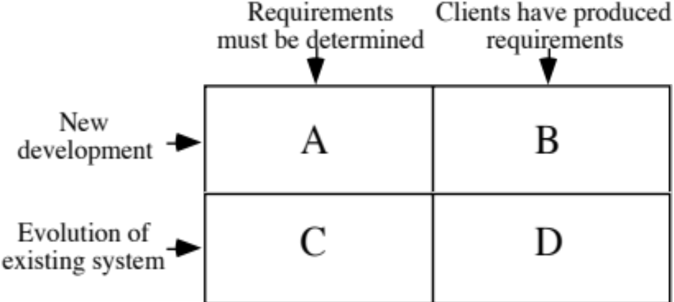
The Starting Point for Software Projects

Slide 16
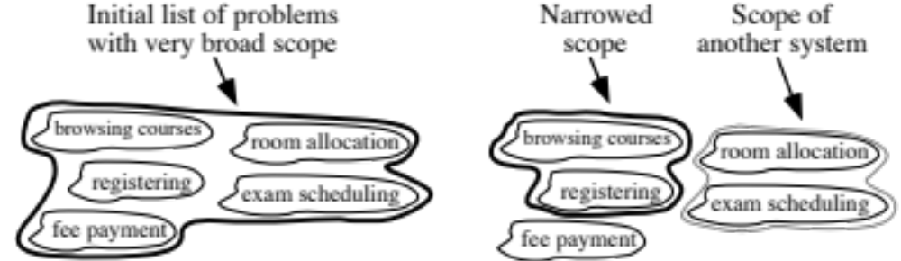
Defining the Scope
Narrow the scope by defining a more precise problem
  List all the things you might imagine the system doing
    Exclude some of these things if too broad
    Determine high-level goals if too narrow
Example: A university registration system

Slide 17
What is a Requirement?
Requirement: A statement about the proposed system that all stakeholders agree must be made true in order for the customer’s problem to be adequately solved.
  Short and concise piece of information
  Says something about the system
  All the stakeholders have agreed that it is valid
  It helps solve the customer’s problem
A collection of requirements is a requirements document.

Slide 18
Types of Requirements
Business requirements
  High-level objectives of the organization or customer who requests the system.
Functional requirements
  Describe what the system should do
  For example, features (use cases)
Non-functional requirements
  Constraints that must be adhered to during development
  For example, quality constraints, technology constraints, process constraints, etc.

Slide 19
Requirements Phase
Goals of requirements phase:
  Fully understand the user requirements.
  Remove inconsistencies, anomalies, etc. from requirements.
  Document requirements properly in an SRS document.

Slide 20
Requirements Phase
Consists of two distinct activities:
    Requirements Gathering and Analysis
    Requirements Specification

Slide 21
Requirements Gathering
Also known as requirements elicitation.
If the project is to automate some existing procedures
  e.g., automating existing manual accounting activities,
  The task of the system analyst is a little easier
  Analyst can immediately obtain:
    input and output formats
    accurate details of the operational procedures

Slide 22
Requirements Gathering (CONT.)
In the absence of a working system,
  Lot of imagination and creativity are required.
Interacting with the customer to gather relevant data:
  Requires a lot of experience.

Slide 23
Analysis

Slide 24
Analysis of the gathered requirements
Main purpose of requirements analysis:
    Clearly understand the user requirements,
    Detect inconsistencies, ambiguities, and incompleteness.
Incompleteness and inconsistencies:
  Resolved through further discussions with the end-users and the customers.

Slide 25
Inconsistent Requirement
Some part of the requirement:
  contradicts with some other part.
Example:
  One customer says turn off heater and open water shower when temperature > 100 C
  Another customer says turn off heater and turn ON cooler when temperature > 100 C

Slide 26
Incomplete Requirement
Some requirements have been omitted:
  Possibly due to oversight.
Example:
  The analyst has not recorded:
  when temperature falls below 90 C
    heater should be turned ON
    water shower turned OFF.

Slide 27
Analysis of the gathered requirements (contd.)
Requirements analysis involves:
  Obtaining a clear, in-depth understanding of the product to be developed,
  Remove all ambiguities and inconsistencies from the initial customer perception of the problem.

Slide 28
Analysis of gathered requirements (contd.)
Experienced analysts take considerable time:
  To understand the exact requirements the customer has in his mind.
Experienced systems analysts know -
often as a result of past (painful) experiences

Slide 29
Analysis of gathered requirements (contd.)
Several things about the project should be clearly understood by the analyst:
  What is the problem?
  Why is it important to solve the problem?
  What are the possible solutions to the problem?
  What complexities might arise while solving the problem?

Slide 30
Analysis of gathered requirements (contd.)
After collecting all data regarding the system to be developed,
  Remove all inconsistencies and anomalies from the requirements,
  Systematically organize requirements into a Software Requirements Specification (SRS) document.

Slide 31
Bad Requirements: A Simplified Example
A mail should be displayed within 3 seconds of clicking on mail
User should be able to add a new mail server during peak hours within a small downtime
Business services should not be interrupted during the peak hours
User should be able to customize all the mailbox settings
User should be able to change the look and feel of how the mailbox is displayed

Slide 32
Quality Requirements
Correct – only user representative can determine
Feasible – get reality check on what can or cannot be done technically or within given cost constraints.
Necessary – trace each requirement back to its origin
Unambiguous – one interpretation
Verifiable – how to you know if the requirement was implemented properly?
Prioritized – function of value provided to the customer

Slide 33
Writing Example #1
“The product shall provide status messages at regular intervals
not less than every 60 seconds.”

Slide 34
Writing Example #1
“The product shall provide status messages at regular intervals
not less than every 60 seconds.”
Incomplete – What are the status messages and how
are they supposed to be displayed?
Ambiguous – What part of the product? Regular interval?
Not verifiable

Slide 35
Alternative #1
1. Status Messages.
1.1. The Background Task Manager shall display status messages in a designated area of the user interface at intervals of 60 plus or minus 10 seconds.
1.2. If background task processing is progressing normally, the percentage of the background task processing that has been completed shall be displayed.
1.3. A message shall be displayed when the background task is completed.
1.4. An error message shall be displayed if the background task has stalled.

Slide 36
Writing Example #2
“The product shall switch between displaying and hiding non-printing characters instantaneously."

Slide 37
Writing Example #2
“The product shall switch between displaying and hiding non-printing characters instantaneously."
Not Feasible – computers cannot do anything instantaneously.
Incomplete – conditions which trigger state switch
Ambiguous – “non-printing character”

Slide 38
Alternative #2
“The user shall be able to toggle between displaying and hiding all HTML markup tags in the document being edited with the activation of a specific triggering condition.”
Note that “triggering condition” is left for design

Slide 39
The Specification Trap
The Landing Pilot is the Non-Landing Pilot until the ‘decision altitude’ call, when the Handling Non-Landing Pilot hands the handling to the Non-Handling Landing Pilot, unless the latter calls ‘go-around,’ in which case the Handling Non-Landing Pilot continues handling and the Non-Handling Landing Pilot continues non-handling until the next call of ‘land,’ or ‘go-around’ as appropriate . In view of recent confusions over these rules, it was deemed necessary to restate them clearly.
British Airways memorandum, quoted in
Pilot Magazine.

Slide 40
Techniques - Gathering and Analyzing Requirements
Observation
  Read documents and discuss requirements with users
  Shadowing important potential users as they do their work
    ask the user to explain everything he or she is doing
  Session videotaping
Interviewing
  Conduct a series of interviews
    Ask about specific details
    Ask about the stakeholder’s vision for the future
    Ask if they have alternative ideas
    Ask for other sources of information
    Ask them to draw diagrams

Slide 41
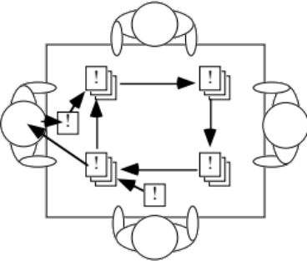
Gathering and Analyzing Requirements
Brainstorming
  Appoint an experienced moderator
  Arrange the attendees around a table
  Decide on a ‘trigger question’
  Ask each participant to write an answer and pass the paper to its neighbour
Joint Application Development (JAD) is a technique based on intensive brainstorming sessions

Slide 42
Gathering and Analyzing Requirements
Prototyping
  The simplest kind: paper prototype.
    a set of pictures of the system that are shown to users in sequence to explain what would happen
  The most common: a mock-up of the system’s UI
    Written in a rapid prototyping language
    Does not normally perform any computations, access any databases or interact with any other systems
    May prototype a particular aspect of the system

Slide 43
Difficulties and Risks in Domain and Requirements analysis
Lack of understanding of the domain or the real problem
  Do domain analysis and prototyping
Requirements change rapidly
  Perform incremental development, build flexibility into the design, do regular reviews
Attempting to do too much
  Document the problem boundaries at an early stage, carefully estimate the time
It may be hard to reconcile conflicting sets of requirements
  Brainstorming, JAD sessions, competing prototypes
It is hard to state requirements precisely
  Break requirements down into simple sentences and review them carefully, look for potential ambiguity, make early prototypes

